Slide 1
ACADEMIC MANAGEMENT SYSTEM
By
MUHAMMED ASHIQUE K A
(MES21MCA-2026)
Product Owner
Vasudevan T V
Assistant Professor
Master of computer applications
MES College of engineering,kuttippuram

Slide 2
Table of Content
Introduction
Existing System
Proposed System
Modules
System Requirement
DFD
Product Backlog
User Story
Project Plan
Sprint
Department of Computer Applications
2

Slide 3
INTRODUCTION
Academic management system is a first phase centralized management project.
Academic Management System is Android application which is helpful for students as well as the college department.
The system helps to various academic processes, including student registration, course scheduling, grading, attendance tracking, and student progress monitoring
The System deals with the various activities related to the students &Teachers
System typically provides a centralized database that enables HoD, teachers, and students to access
The internal marks of the student are added in the database and so students can also view the marks whenever they want.
Department of Computer Applications
3

Slide 4
EXISTING SYSTEM
The thorough and clear understanding of the existing system involves the study of important data entities in the system, major centers where action is taken, the purpose of the different actions that are performed. There are some present computerized system existing.
Department of Computer Applications
5

Slide 5
PROPOSED SYSTEM
An AMS Android app is a mobile application that allows students, teachers to access an academic management system from their mobile devices. The app provides convenient access to various features and functionalities of the AMS, making it easier to manage academic-related activities
Student profile and attendance management: Students can view their academic profile, including attendance records and internal marks report .
Course and schedule management: Students can view their time table, course materials, and assignments.
Communication : Students can communicate with their teachers through messaging and announcements.
Notification : The app can send notifications to students regarding upcoming assignments and other important information.
Reporting and analytics: Students can view reports and analytics on academic performance, attendance.
Department of Computer Applications
6

Slide 6
MODULES
1. HoD:
HoD can login in the system.
HoD can manage Teachers.
HoD can manage Subjects
Add/delete Students
Manage Time Table
Manage Fees Details
View Feedback
View Attendance
Manage Announcement
Department of Computer Applications
7

Slide 7
2. Teacher:
login to the system
Subject planner
View Students
View Timetable
Manage Assignments
Manage Internal marks
Manage Exams
Manage Study Materials
Feedback & Survey
Manage Attendance
View Announcement
View/Manage Profile
Chat with Student
3. Student:
login to the system
View Timetable
View Subjects
Post Assignment s
View Internal marks
Post Exams
Use Study Materials
Post Feedback & Survey
View Attendance
View Announcement
View/Manage Profile
Chat with Teachers
View Fees Details
Department of Computer Applications
8

Slide 8
SYSTEM REQUIREMENT
Operating System : Windows 10 or above
Front End : HTML, CSS, Java script,xml
Back End : Python (Flask),JAVA(Android)
Data Base : Mysql
Software used : Pycharm, Android studio
Browser : Internet Explorer/ Mozilla Firefox
Department of Computer Applications
9

Slide 9
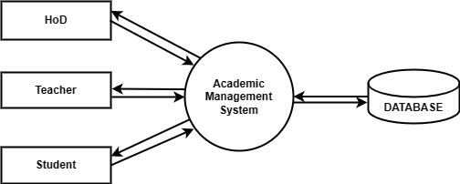
Level:0
DFD
Department of Computer Applications
10

Slide 10
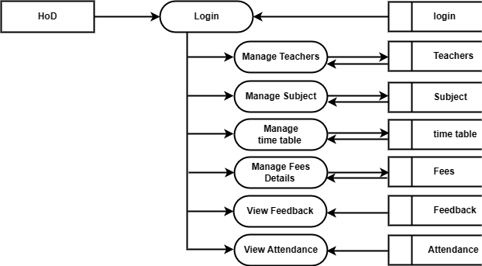
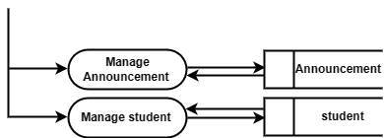
Level:1
Department of Computer Applications
12

Slide 11
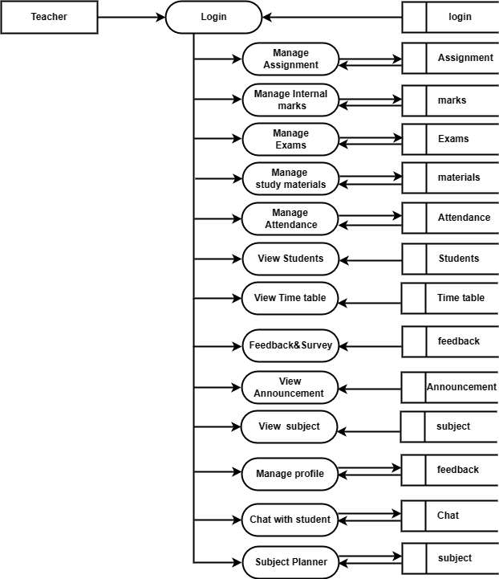
Level:1
Department of Computer Applications
13

Slide 12
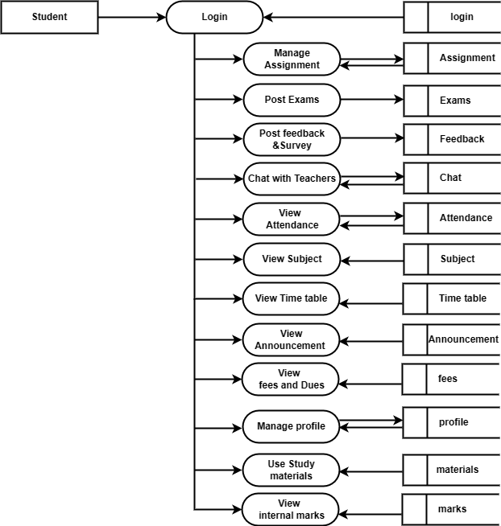
Level:1
Department of Computer Applications
14

Slide 13
PRODUCT BACKLOG
Id | Name | Priority | Status
1 | Registration | High | Planned
2 | Login | High | Planned
3 | Subject planner | High | Planned
4 | Manage Assignments | High | Planned
5 | Manage Internal marks | High | Planned
6 | Manage Exams | High | Planned
7 | Feedback & Survey | High | Planned
8 | Manage Attendance | High | Planned
9 | Chat with Student | High | Planned
10 | Report | Medium | Planned
Department of Computer Applications
15

Slide 14
USER STORY
User Story Id | As a <Type of User> | I want to < perform some task> | So that I can <Achieve my goal>
1 | HoD | Login | Access the system
2 | HoD | Register Student | Add/ Delete Student
3 | Student | Login | Access the System
4 | Student | Registration | Add there details
5 | HoD | Manage Teachers | Add/delete Teachers
6 | Teacher | Login | Access the System
7 | Teacher | Registration | Add there details
8 | Hod | Manage Subject | Add or delete Subject
9 | Teacher | View there Subject | View There Duties
10 | Students | View All Subject | View there subjects
Department of Computer Applications
16

Slide 15
User Story Id | As a <Type of User> | I want to < perform some task> | So that I can <Achieve my goal>
11 | HoD | Manage Time table | Add / edit Time table
12 | Teacher | View Timetable | View Timetable
13 | Student | View Timetable | View Timetable
14 | HoD | Manage fees details | Updates there fees details
15 | Student | View there fee details | View there fees and dues
16 | Teacher | Subject Planner | Manage class topics
17 | Teacher | View Students | View students details
18 | Teacher | Manage assignment | Add/delete assignment
19 | Student | Post there assignment | Add there assignment works
20 | Teacher | Manage internal marks | Add or delete internal mark
Department of Computer Applications
17

Slide 16
User Story Id | As a <Type of User> | I want to < perform some task> | So that I can <Achieve my goal>
21 | Students | View there Internal mark | View There marks
22 | Teachers | Manage exams | Add exams
23 | Student | Post there exams | Attend exams
24 | Teacher | Manage study materials | Add /delete study materials
25 | Student | Use study materials | Use study materials
26 | Teacher | Manage attendance | Post students attendance
27 | Student | View there attendance | View there attendance on date
28 | Hod | View Students attendance | View students attendance details
29 | Teacher | Chat with students | Chat with students
30 | Student | Chat with Teacher | Chat with Teacher
Department of Computer Applications
18

Slide 17
User Story Id | As a <Type of User> | I want to < perform some task> | So that I can <Achieve my goal>
31 | Student | Post feed back | Add feed backs
32 | Teachers | View feed back | View feed back
33 | Hod | View feed back | View feed back
34 | HoD | Manage Announcement | Post Announcement
35 | Teacher | View Announcement | View Announcement
36 | Student | View Announcement | View Announcement
Department of Computer Applications
19

Slide 18
PROJECT PLAN
User Story ID | Sprint | Start Date | End Date | Days | Status
1,2,3,4,5,6,7,8,9,10 | Sprint 1 | 07/02/2023 | 03/02/2023 | 21 | Planned
11,12,13,14,15,16,17,18,19,20 | Sprint 2 | 04/03/2023 | 25/03/2023 | 21 | Planned
21,22,23,24,25,26,27,28,29,30 | Sprint 3 | 02/04/2023 | 23/04/2023 | 21 | Planned
31,32,33,34,35,36 | Sprint 4 | 24/04/2023 | 15/05/2023 | 21 | Planned
Department of Computer Applications
20

Slide 19
THANK YOU...

